Slide 1
CISC 851: FINAL PROJECT ALAN DIMITRIEV

Slide 2
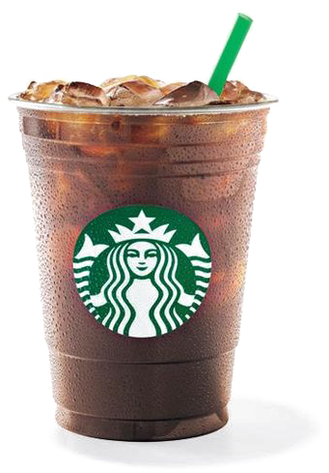

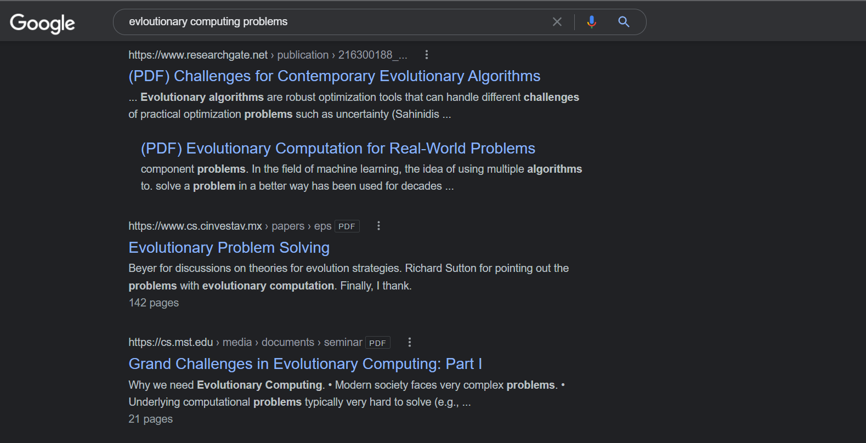
PREFACE

Slide 3

PREFACE

Slide 4
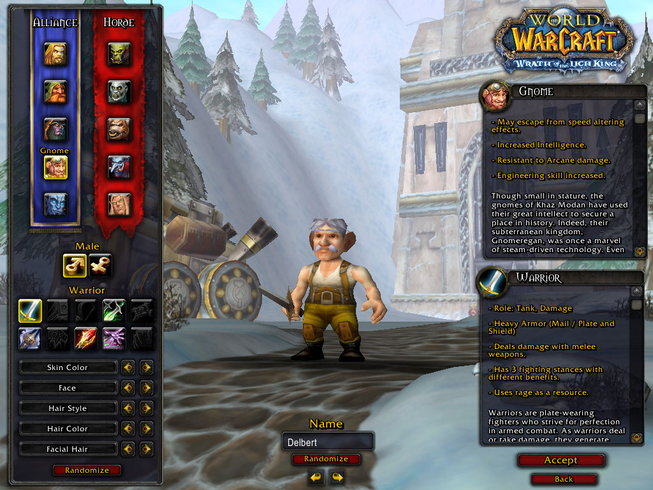
PREFACE

Slide 5
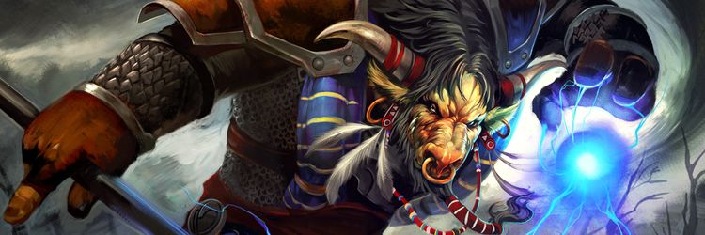
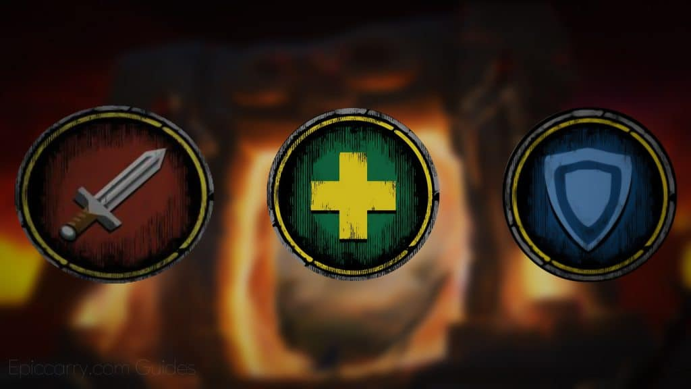
PREFACE
SHAMAN

Slide 6
PROBLEM DESCRIPTION
What is the best single target healing spell rotation for shamans

Slide 7
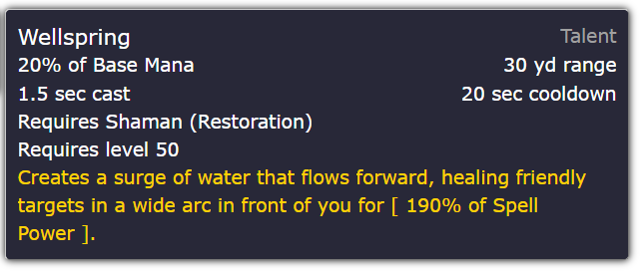

PROBLEM DESCRIPTION
Cast Time
Cooldown Time
Spell Effect

Slide 8



PROBLEM DESCRIPTION
What is the best single target healing spell rotation for shamans
What is the best single target healing spell rotation for shamans
Things To Keep In Mind:
-Global Cooldowns
-Spell Specific Cooldowns
-Spells that affect other spells
Example:

Slide 9
EVOLUTIONARY ALGORITHM:
Representation
Healing Surge
Healing Rain
Downpour
Healing Surge
Healing Surge
Riptide
Healing Totem
Chain Heal
How would a ‘spell rotation’ be represented?
0.0
0.5
1.0
1.5
2.0
2.5
3.0
3.5
Rotation = [‘Healing Surge’, ‘Chain Heal’, Healing Rain’, Downpour’,…]

Slide 10
EVOLUTIONARY ALGORITHM:
Fitness
Sequentially go through each ability in the rotation, evaluating its effects according to the game rules.
Healing Surge
Healing Rain
Downpour
Healing Surge
Healing Surge
Riptide
Healing Totem
Chain Heal
Cast Time
Global Cooldown
Goal:
Maximize total healing percentage
0.0
0.5
1.0
1.5
2.0
2.5
3.0
3.5
0%
0%
0%
+248%
0%
0%
+170%
0%
(+132% over 18 seconds)
+7.33%

Slide 11
EVOLUTIONARY ALGORITHM:
Parent and Survivor Selection
Similar in a sense to Assignment #2 from the course:
-Steady State Model
λ( < μ)
-Tournament Selection
-Flexible number of tournaments/tournament sizes
-Replace Tournament Losers With Offspring

Slide 12
EVOLUTIONARY ALGORITHM:
Recombination
Healing Surge
Healing Rain
Downpour
Healing Surge
Healing Surge
Riptide
Healing Totem
Chain Heal
Unleash Life
Healing Totem
Healing Wave
Riptide
Healing Surge
Healing Wave
Healing Surge
Riptide
CROSSOVER!
Healing Surge
Healing Rain
Downpour
Riptide
Healing Surge
Healing Wave
Healing Surge
Chain Heal
-Investigate if 1, 2 or 3 point works better
Unleash Life
Healing Totem
Healing Wave
Healing Surge
Healing Surge
Riptide
Healing Totem
Riptide

Slide 13
EVOLUTIONARY ALGORITHM:
Mutation
Point Mutations
Healing Surge
Healing Rain
Downpour
Healing Surge
Healing Surge
Riptide
Healing Totem
Chain Heal
Parent:
Healing Surge
Unleash Life
Downpour
Healing Surge
Healing Surge
Downpour
Healing Totem
Chain Heal
Child:

Slide 14



EVOLUTIONARY ALGORITHM:
Implementation & Results
WORK IN PROGRESS

Slide 15
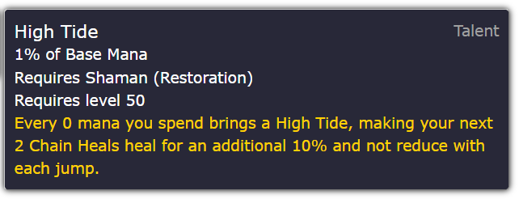
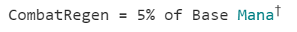
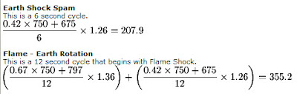
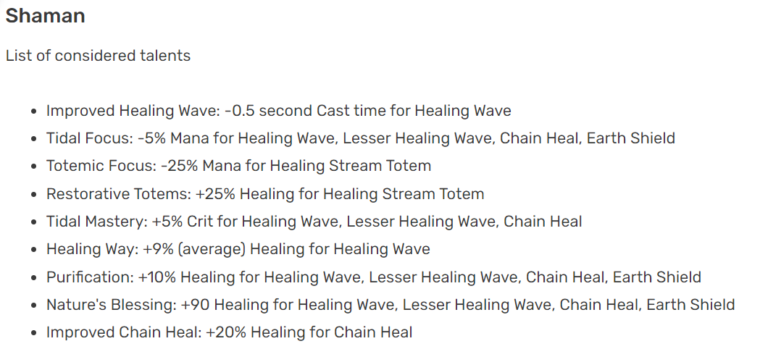

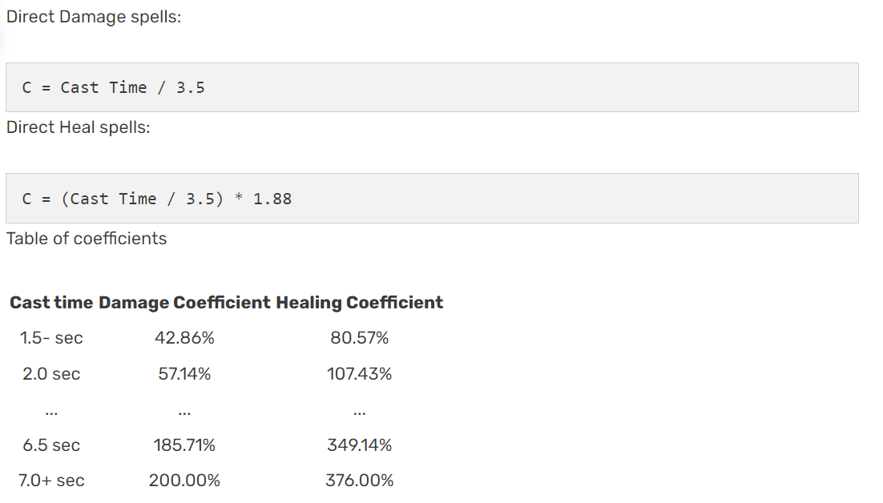
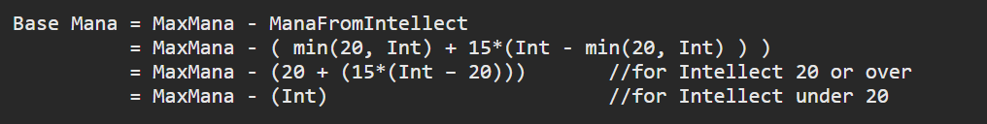
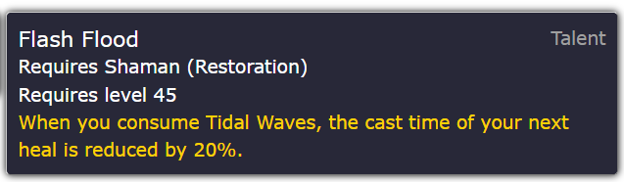
EVOLUTIONARY ALGORITHM:
Implementation & Results

Slide 16
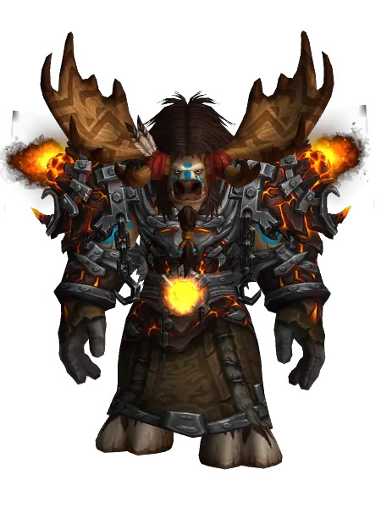
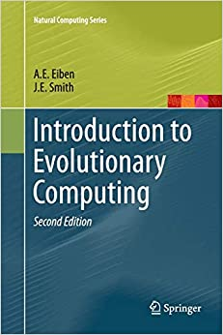
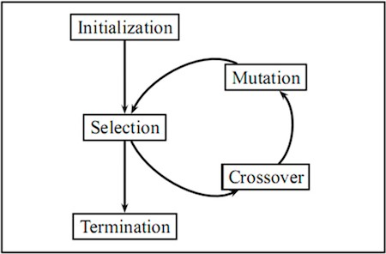
CONCLUSION
+300%
+248%
+7.33%
+170%

Slide 17
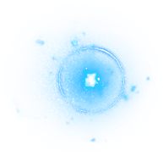
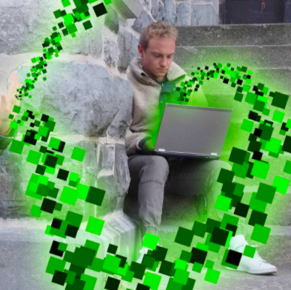
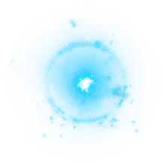
Thanks For Listening! Feel free to reach out to me at: alan.dimitriev@queensu.ca

